Slide 1


Calabash-android
workshop
Lesson 1: Installation

Slide 2
Prerequisites
- Ruby 1.9.3 (ver. 2.0.0 not compatible)
http://www.ruby-lang.org/pl/downloads/
- Android SDK (API 18 not compatible)
http://developer.android.com/sdk/index.html
- Apache Ant
http://ant.apache.org/bindownload.cgi
- Java JDK 7
http://www.oracle.com/technetwork/java/javase/downloads/index.html

Slide 3
Environments
- variable: ANDROID_HOME value: C:\android-sdk
- variable: JAVA_HOME value: C:\Program Files\Java\jdk1.7.0_06
- variable: path value: C:\apache-ant-1.8.4\bin
- variable: path value: C:\android-sdk\platform-tools\

Slide 4
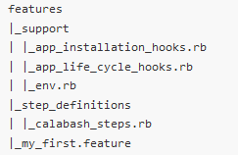
Cucumber skeleton
command: calabash-android gen

Slide 5
Lets run first test!
calabash-android run <apk>

Slide 6
Useful links
-https://github.com/calabash/calabash-android
-https://groups.google.com/forum/?fromgroups#!forum/calabash-android

